Slide 1
DIVA Model Overview
Hasini Weerathunge
Stepp Lab for Sensorimotor Rehabilitation Engineering
12/30/2019

Slide 2
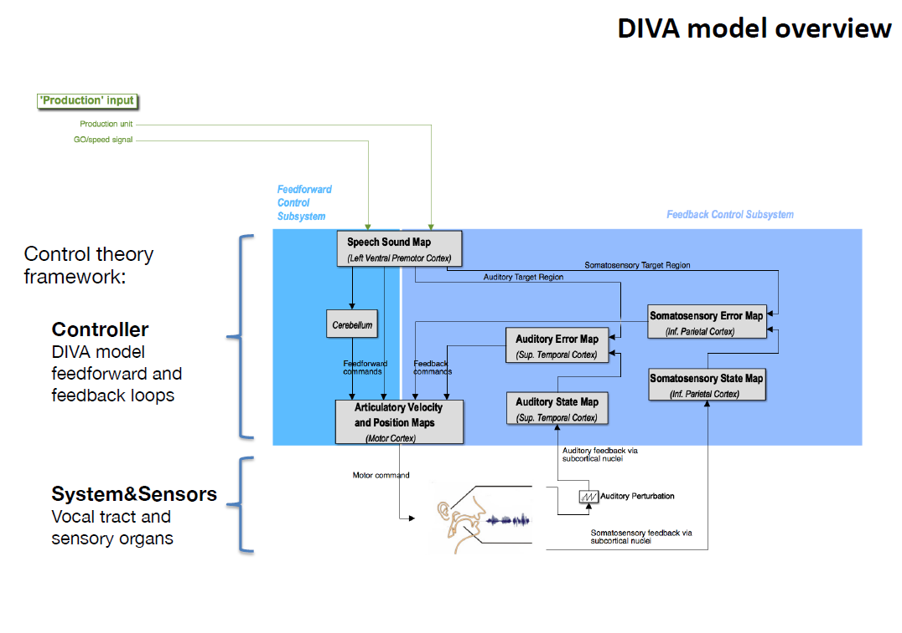
DIVA Model Overview
Adapted from SH680 Frank H. Guenther, Alfonso Nieto-Castañón

Slide 3
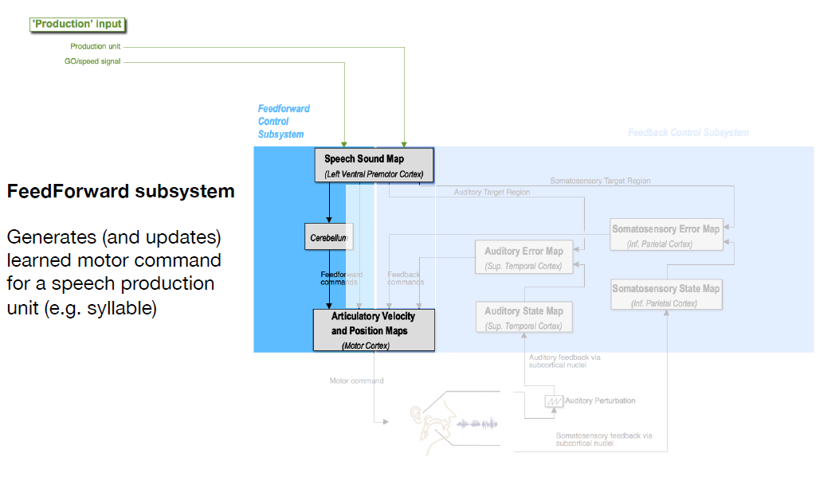
Adapted from SH680 Frank H. Guenther, Alfonso Nieto-Castañón

Slide 4
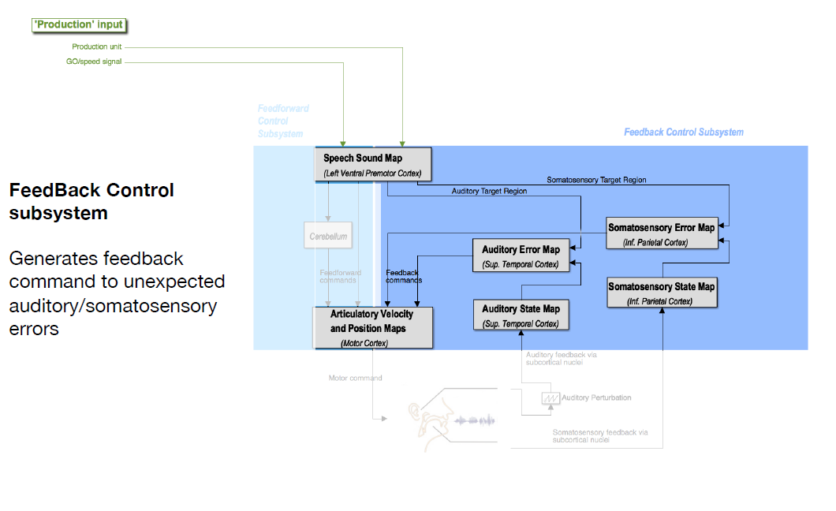
Adapted from SH680 Frank H. Guenther, Alfonso Nieto-Castañón

Slide 5
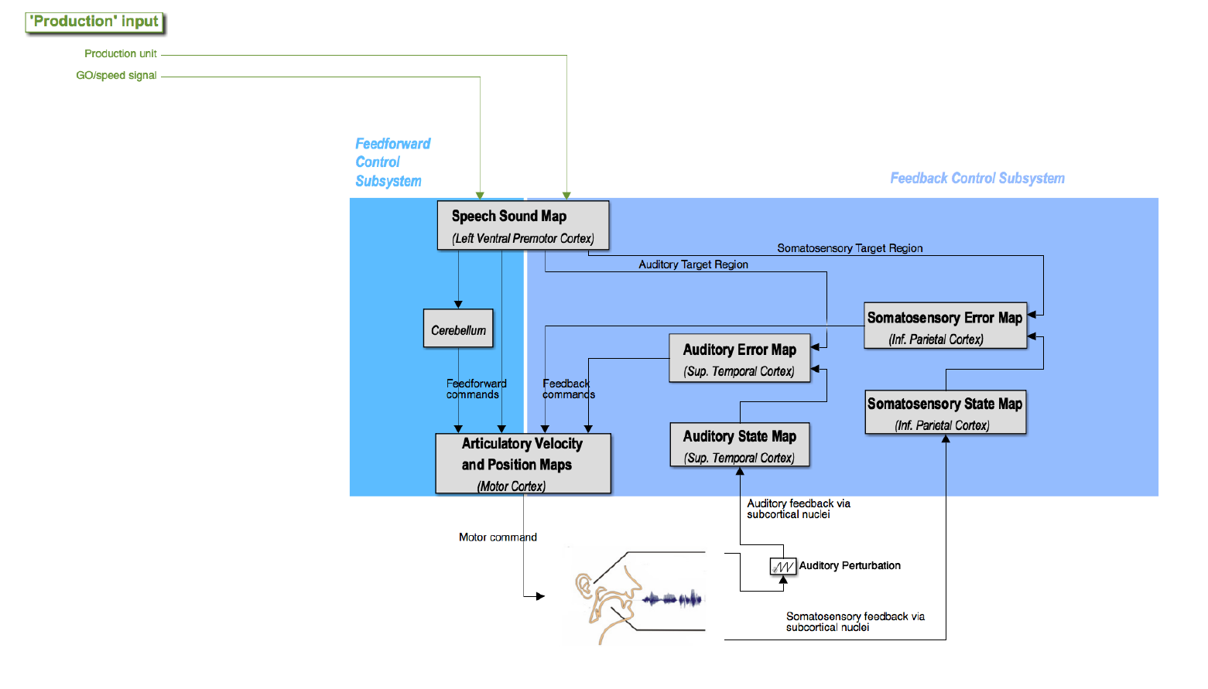

Slide 6
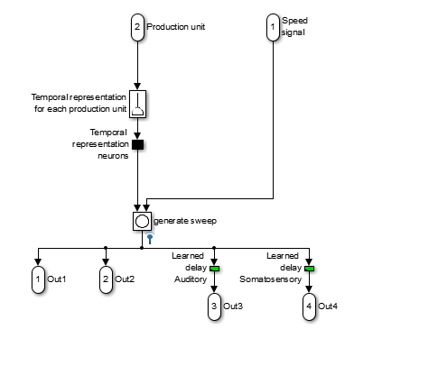
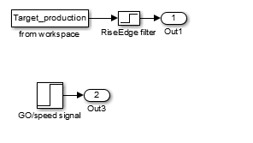
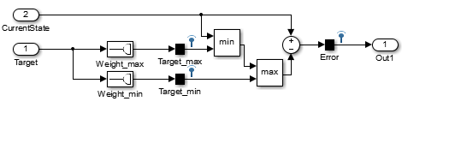
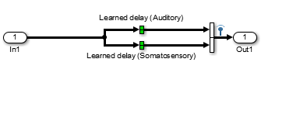
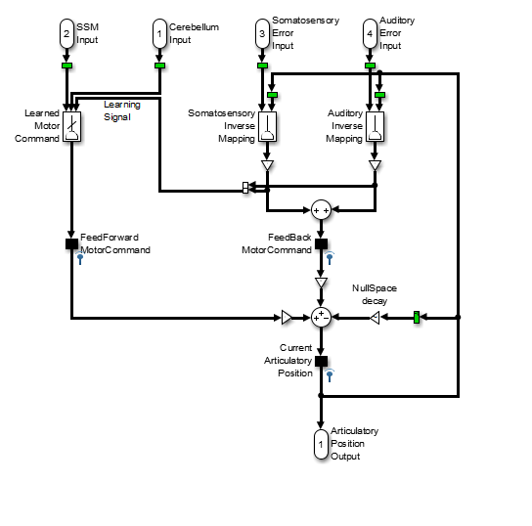
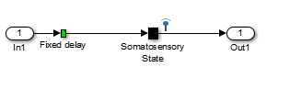
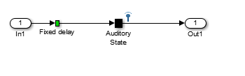
Simulink DIVA model represents the implementation of DIVA model.
Model contains different sub modules, representing different brain areas involved in speech production.
The operation of each module is implemented through standard Simulink block operations. (Inputs and Outputs)
There are also several non-standard blocks, implemented as Simulink level-2 Matlab S-functions. (Can be found by “looking under the mask”)
Block specific parameters are accessible by double clicking the blocks.

Slide 7
^{Vocaltract block /}
^{diva_synth.m}

Slide 8








DIVA Simulink elements
Model Element | Symbol in Simulink
Delay elements
Gain elements
Slider-gain elements
Synaptic weight elements (explicit)
Synaptic weight elements (adaptive)
Inverse-map elements
Null-space projector elements
Concatenation elements
Notes:
Delay elements : Fixed-delayed elements. DIVA model is implemented using discrete fixed-step elements, where a unit delay corresponds to the fixed-step size (fundamental sample time, currently 5ms) Double click to chance associated delay time
Gain elements : Gain factors in mode. Double clicking allows user to modify the associated gain factors
Slider-gain elements : Activation of neural populations of interest. Selectively increase/decrease the activity of these neurons to explore model behavior under non-standard conditions (double click to access)
Synaptic weight elements : Two types od synaptic weight elements in Simulink DIVA.
Standard weight elements (SSM and error maps) implement weights that can be modelled as a simple matrix multiplication (diva_weights.m) Double click to define specific matrix characterizing each synaptic weight element.
Each mat file contains a variable named W.
Rows indicate dimensionality of the inputs. Columns indicate dimensionality of outputs. Y=Wt.x.
W0 is a bias element (the output y in the case of x = 0)
Adaptive weight element (Motor Cortex module implementing feedforward map) is a standard weight element where weights can be adaptively modified via additional learning inputs. Double clicking on these elements allow user to define learning rate as well as starting state of the matrix characterizing each adaptive synaptic weight element.
The adaptive weight element contains three inputs. x,a and b.
Output is y = Wt.x. In addition, weights are incremented at each time-point by a factor proportional to deltaW=a.bt.
Functionality implemented in diva_weightsadaptive.m
Inverse-map element : Implements an explicit computation of inverse Jacobian of the vocal tract model.
Double clicking these elements allow user to modify
The portion of the output of the vocal tract model to be used in each case ( auditory or somatosensory information)
The Jacobian estimation step size ( step size increments in the articulatory configuration around the current articulation position used to estimate the forward map Jacobian)
The Jacobian regularization factor (degree of regularization used when computing the pseudoinverse of the Jacobian)
Null-space projector element : Implements a null-space projection of the current articulatory state. Null-space projection is defined as the operation that projects an input vector on the null space of the Jacobian of the forward map at the current articulatory state. Double clicking this element allows user to define
A multiplicative gain factor to be applied to the null-space projection output
b) The portion of the output of the vocal tract model to be used when estimating the forward map null-space (Auditory/Somatosensory information)
c) The Jacobian estimation step size
d) The Jacobian regularization factor

Slide 9
DIVA Model
Individual Modules
Click module
Click key to move forward
Click to move back to this slide

Slide 10
Representations in DIVA
Motor Representations
10 vocal tract shapes
3 source parameters ( tension, pressure, voicing )
Auditory Representations
f_{o ,}F1, F2, F3
Somatosensory Representations
6 places of articulation dimensions
2 source dimensions ( pressure, voicing)
*In the diagrams which follow each representation will be specifically colored.

Slide 11
Vocal tract model called with parameters
Auditory
Somatosensory
Voice
Auditory&Somatosensory
Vocal tract model called with no parameters

Slide 12
Speech Sound Map
SSM gets input from target production neurons (one neuron per production).
Once these inputs are active, these select a set of neurons associated with the given production (one neuron per each time point of a production).
When SSM detects activation signal (GO), a sweep of activation is provided to the set of activated neurons.
Velocity of the activation determined by amplitude of the GO signal.
Activation of these neurons projected to different areas through delayed channels
Feedforward
To Motor Cortex articulatory velocity and position maps (no additional delay)
To Cerebellum (learned delay)
Feedback
To Auditory and Somatosensory Error maps (with specific delays)

Slide 13
DIVA target productions
Base target productions and their vocal tract input time series are stored in mat files indexed diva_00000x.mat
These time series contains
VT input information ( 13 dimensions x 51 time points)
Sampling rate = 200 Hz / Contains 250 ms (?)
Auditory/Somatosensory Target areas [min,max]

Slide 14
Speech Sound Map
To
Cerebellum
To
Articulatory
Velocity and
Position Map
Auditory
Target
Region
Somat.
Target
Region
Feedforward commands
Feedback commands
*All Motor Representations

Slide 15
Cerebellum
Outputs from Speech sound map are delayed and send to Motor Cortex via Cerebellum
This learned delay makes the feedforward projections from SSM reach Motor cortex at the same time the feedback projections arrival from auditory and somatosensory feedback systems
Both these signal pathways are then used for learning
SSM has fixed delay values: (discrete)1 unit of delay corresponds to 5 ms
Cerebellum has convolution blocks of delay ^{diva_hanning.m}
a convolution with a hanning window is used to smooth the error assignment.
Motor cortex will spread any given error-corrective motor command around the time-points close to the error –inducing production when adapting the feedforward command.
This leads to smoother learned articulatory sequences

Slide 16
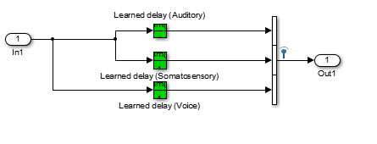
Cerebellum
Proposed Change
*All Motor Representations

Slide 17
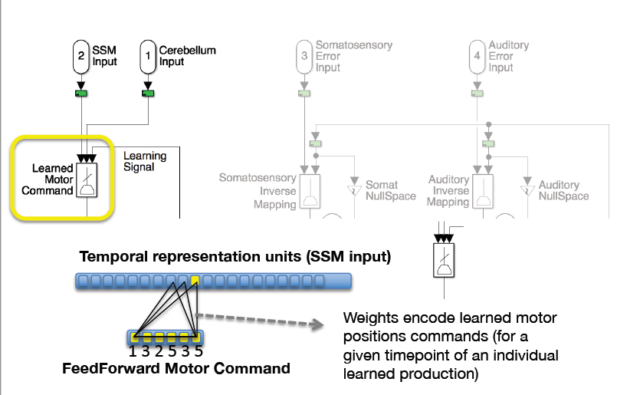
Articulatory, Velocity and Position map in Motor Cortex
Inputs from auditory and somatosensory error maps are converted to corrective motor commands via a learned set of weights ( implemented as an inverse mapping auditory/somatosensory direction to motor direction)
Motor correction signals are combined to make the feedback motor command
Inputs from SSM are converted to feedforward motor command (through an adaptive set of weights) ^{diva_weights_adaptive.m}
Motor command is represented by 13 neurons
10 neurons for vocal tract shape (refer to Maeda)
3 neurons for glottal control parameters
Glottal tension – for simplicity translated to f_{o}
Glottal pressure
Vocal fold oscillation – voicing information
Adapted from SH680 Alfonso Nieto-Castañón

Slide 18
Articulatory, Velocity and Position map in MC
Inputs from auditory and somatosensory error maps are converted to corrective motor commands via a learned set of weights ( implemented as an inverse mapping auditory/somatosensory direction to motor direction)
Motor correction signals are combined to make the feedback motor command
Inputs from SSM are converted to feedforward motor command (through an adaptive set of weights) diva_weights_adaptive.m /diva_weights_SSM2FF.mat
Motor command is represented by 13 neurons
10 neurons for vocal tract shape (refer to Maeda)
3 neurons for glottal control parameters
Glottal tension – for simplicity translated to f_{o}
Glottal pressure
Vocal fold oscillation – voicing information
Temporal representation units (SSM input)
Feedforward Motor Command

Slide 19
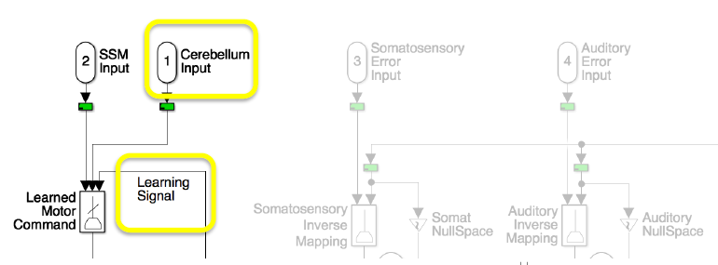
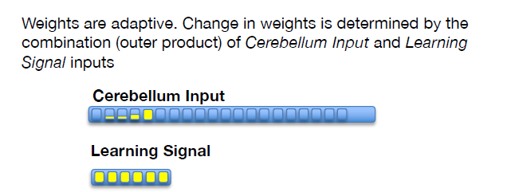
Articulatory, Velocity and Position map in MC
Inputs from auditory and somatosensory error maps are converted to corrective motor commands via a learned set of weights ( implemented as an inverse mapping auditory/somatosensory direction to motor direction)
Motor correction signals are combined to make the feedback motor command
Inputs from SSM are converted to feedforward motor command (through an adaptive set of weights)
Feedback corrective motor commands are projected as learning signal to feedforward weights

Slide 20
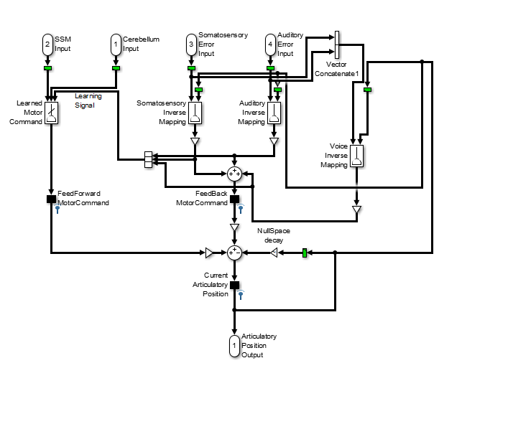
Articulatory Velocity and Position Maps
Proposed change
*All Motor Representations except for colored
Notes:
All of the motor representations are characterized by a set of 13 neurons, encoding sparsely (0ne neuron per articulatory feature) the shape of vocal cavity (10 articulatory dimensions), and glottal control parameters ( 3 dimensions; glottal tension, assumed for simplicity linearly related to the resulting pitch; glottal pressure and vocal fold oscillations – voicing – information)

Slide 21
Articulatory Velocity and Position Maps
Vocal tract model called with Somat. Param.
^{diva_weightsexplicit.m}
^{diva_weightsexplicit.m}
Vocal tract model called with Auditory Param.
^{diva_weightsadaptive.m/}
^{diva_weights_SSM2FF.mat}
^{diva_nullspacegain.m}
Vocal tract model called with Aud&Som. Param.
*All Motor Representations except for colored
Notes:
All of the motor representations are characterized by a set of 13 neurons, encoding sparsely (0ne neuron per articulatory feature) the shape of vocal cavity (10 articulatory dimensions), and glottal control parameters ( 3 dimensions; glottal tension, assumed for simplicity linearly related to the resulting pitch; glottal pressure and vocal fold oscillations – voicing – information)

Slide 22
Vocal tract Module
Outputs are utilized in auditory and somatosensory state map blocks
DIVA_synth.m script is called inside the vocal tract block
DIVA_synth incorporates motor representations (i.e. muscle activations) to generate
Glottal source
Vocal tract filter
Voicing and pressure signals
The above outputs are utilized to form
Auditory and Somatosensory representations
Acoustic signal

Slide 23
Vocal Tract Module
Inputs ^{(Motor Commands)}
10 vocal tract shape parameters
3 source parameters
(tension, pressure, voicing)
Outputs (Acoustic and Somat. Representations of produced sound)
Auditory parameters
f_{0 ,} F1, F2, F3
Somatosensory parameters
6 place of articulation dimensions
2 source dimensions (pressure, voicing)
Acoustic signal

Slide 24
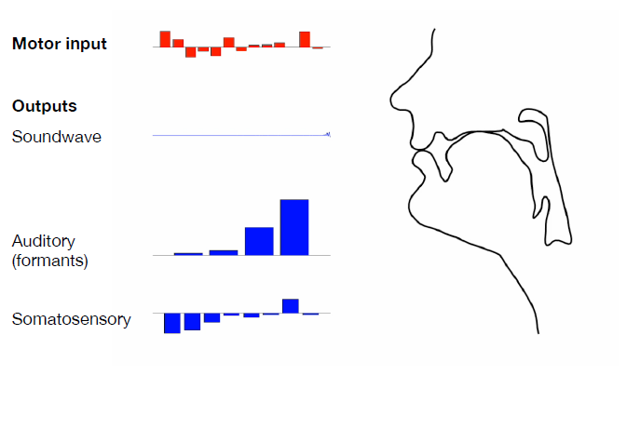
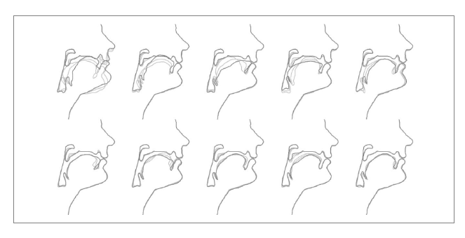
Motor Representation
Input to Vocal Tract Module (13 dimensions)
Ten vocal tract shape dimensions
Three source dimensions
Tension
Pressure
Voicing
Adapted from SH680 Frank H. Guenther, Alfonso Nieto-Castañón

Slide 25
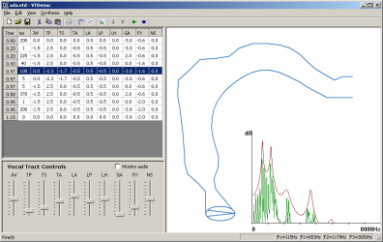
Vocal Tract Model ( Maeda)
Parameter | Description
JW | Jaw Height (effect on voicing)
TP | Tongue Position
TS | Tongue Shape
TA | Tongue Apex
LA | Lip Area
LP | Lip Protrusion
LH | Larynx Height
GA | Glottal Area
FX | Fundamental Frequency
NS (3.5 only) | Velo-pharyngeal port
10 variables to determine vocal tract shape for each production
Maeda, S. (1982), "A digital simulation method of the vocal-tract system", Speech Communication, 1, 199-229.
Notes:
https://www.phon.ucl.ac.uk/resource/vtdemo/

Slide 26
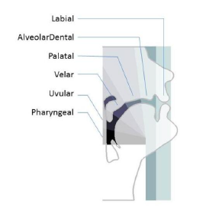
Somatosensory/Auditory representation
Output of Vocal Tract Module (12 dimensions)
Auditory parameters
Four formant dimensions (f_{o} , F1, F2, F3)
Somatosensory parameters
Six place of articulation dimensions
Two source dimensions
Pressure
Voicing
Adapted from SH680 Frank H. Guenther,
Alfonso Nieto-Castañón

Slide 27
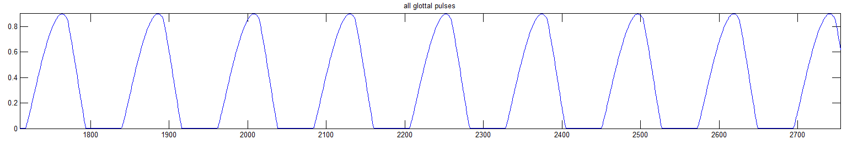
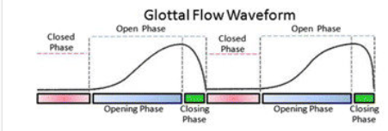
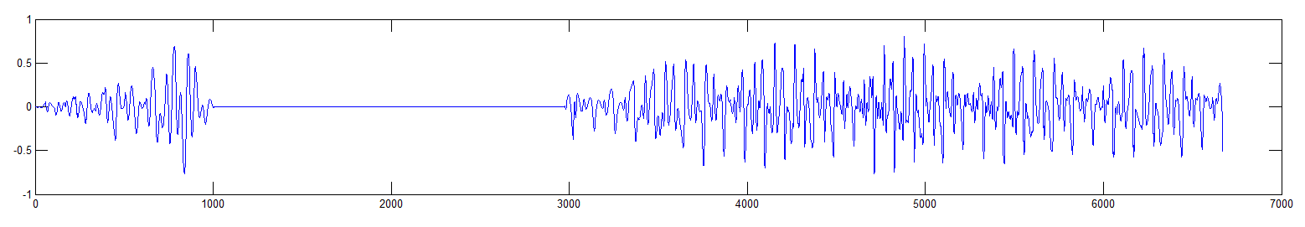
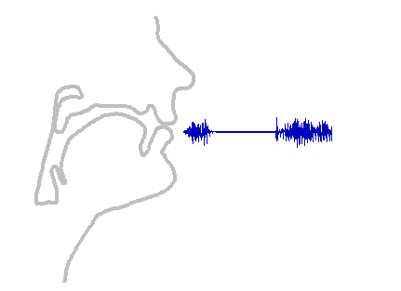
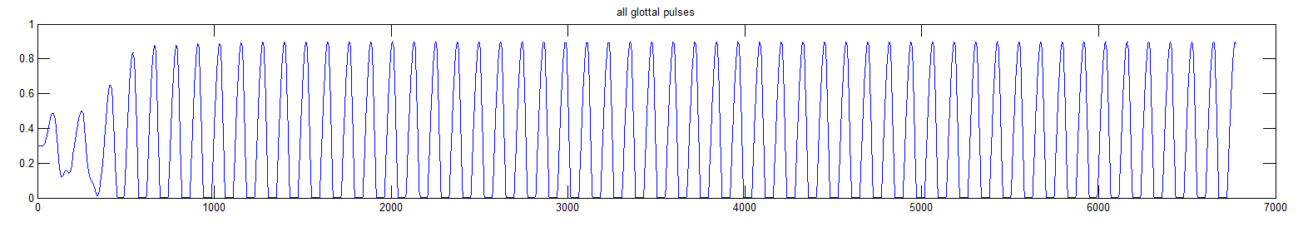
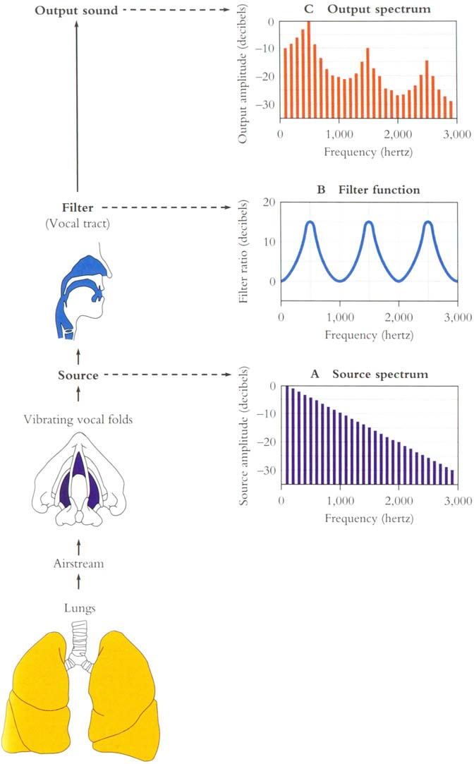
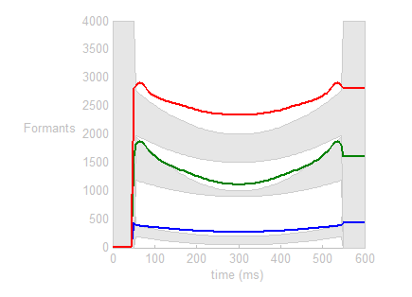
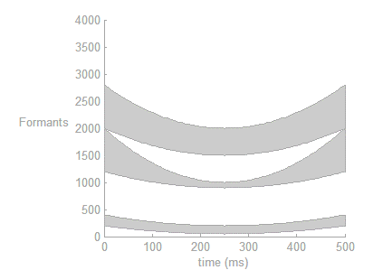
Sound Synthesizer
Generate Glottal Pulse
Compute vocal tract filter
Compute Sound Signal
Consider vocal fold open and closure timing

Slide 28
Auditory Error Map
Current auditory state is encoded (one neuron per feature)
F0, F1, F2, F3
Projections from SSM are converted to desired auditory representations via synaptic weights
diva_weights_SSM2amax.mat/ diva_weights_SSM2amin.mat (for auditory)
diva_weights_SSM2smax.mat/ diva_weights_SSM2smin.mat (similarly for somatosensory –in next slide)
Desired auditory target is defined as maximum and minimum value for each auditory feature
Signals are compared and auditory error signal is generated
Projected to Motor cortex (right ventral premotor Cortex)

Slide 29
Somatosensory Error Map
Similar to auditory error map
Delays are lower compared to auditory signals
Current somat. state is encoded (one neuron per feature)
Vocal tract place of articulation parameters
Glottal pressure
vocal fold oscillations (voicing) information

Slide 30

Auditory State Map
Somatosensory State Map

Slide 31
Current capabilities in DIVA to include controlled f₀
Vocal tract (block) input contains 3 source parameters : tension, pressure, voicing (vocalTract[11:13])
Sensory feedback contains f₀ (Auditory[1]) and pressure, voicing (Somatosensory[7,8]) parameters
Vocal tract (block) contains a glottal pulse generating module which can be fed different source parameters (tension, pressure, voicing), to output glottal pulse shape, f₀ and pressure, voicing information.
For controlled f₀ model:
Glottal pulse generator module should be replaced by vocal fold model
Feedback system should take in varied f_{o} (incorporate it to acoustic signal)
Inverse model for source parameters should be implemented in Motor cortex
Send a feedforward error correction signal back to vocal folds to do corrections

Slide 32
DIVA : current modifications for controlled f₀
DIVA latest version (MATLAB 2017a)
DIVA utilizes a constant glottal pulse to generate its source (monotonic)
LeDIVA contains DIVA with glottal source replaced by LeTalker
An internal model of glottal waveform generation
A pre-calculated forward model for inverse mapping
Working version in MATLAB 2013b

Slide 33
Changes in DIVA when applying new VF model
Pre-calculate motor input – sensory output combinations:
Need to recalculate divaVoiceSmooth.m which is utilized in diva_synth.m (vocal tract) to convert source parameters in motor representations to source parameters in auditory and somatosensory representations
E.g: Vocal fold tension, lung pressure and vocal fold distance (voicing parameter) affect auditory f_{o} output
Input parameters interact with each other non-linearly (Observation by Gabe Cler and Janis Intoi’s work on LeDIVA)
Need to attach glottal source generation module (actual vocal fold model) to diva_synth.m module
Remove voice feedback and feedforward modules and incorporate them inside auditory and somatosensory modules
Discussion point: should Voice be considered a separate feedback module OR be incorporated into current variables in somatosensory and auditory components?

Slide 34
Changes in VF model when applying DIVA
Can the VF model be called iteratively (for each time point of an utterance) ?
Call VF model iteratively by DIVA
Pass the train of glottal pulses to DIVA
If the current Vocal tract model has a vocal tract attached to it, decide whether to use it or the vocal tract of DIVA
VF forward Model
For all input glottal source parameters of DIVA (CT tension, airway pressure and voicing information), map out all output source parameters (f_{o} , pressure, voicing), by identifying all combinations of inputs and outputs in Vocal tract model
Is this a good idea? What about scalability of this concept?
If not, call VF model iteratively here as well
Current forward model might not have the closest approximation to the biological version

Slide 35
Voice Quality : Utilizing glottal pulse shape
Voice quality changes are reflected in
Glottal pulse shape
Vocal fundamental frequency
Other parameters related to source (level of noise? Voicing/pressure?)
Currently, DIVA is only considering f₀ to generate outputs of vocal tract block
Pulse shape generated by vocal folds model not utilized in DIVA
We need;
A mechanism to utilize both f₀ AND glottal pulse shape to generate voice
How does glottal pulse change based on vocal quality? Some insights from VF modelling
How should it be attached to the feedback loop? Separate loop?
Affective prosody is controlled by limbic and Para limbic systems (ACC/PAG)
Consider vocal quality changes related to vocal fold anatomy (nodules etc) only?

Slide 36
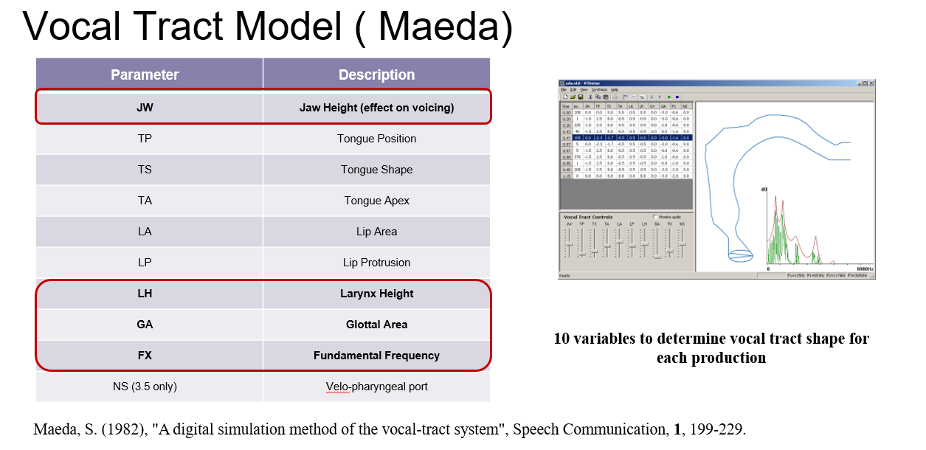
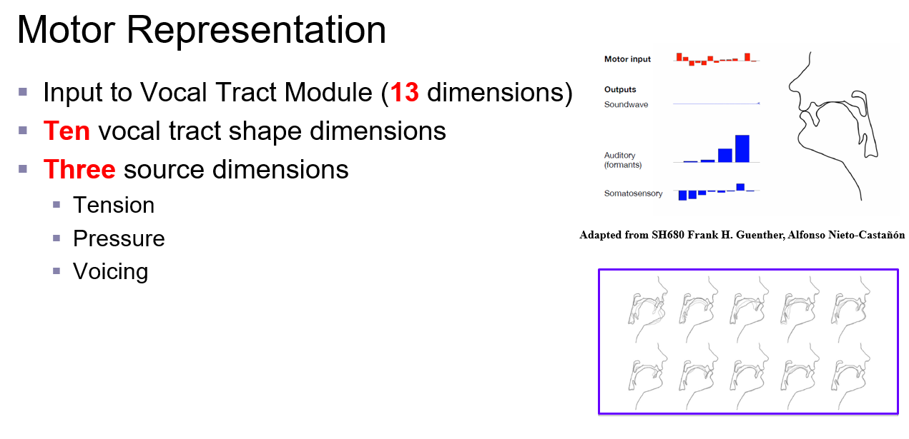
Vocal Tract utilized : Maeda
The 10 parameters defining vocal tract shape also contains some parameters which define voicing and fundamental frequency

Slide 37
Vocal Tract utilized : Maeda
The 10 parameters defining vocal tract shape also contains some parameters which define voicing and fundamental frequency.
Discussion points:
Should we utilize the current vocal tract model?
If so, should we update these parameters which are also based on source parameters?

